Slide 1
SUBNETTING

Slide 2

IP addresses are designed with two levels of hierarchy.

Slide 3
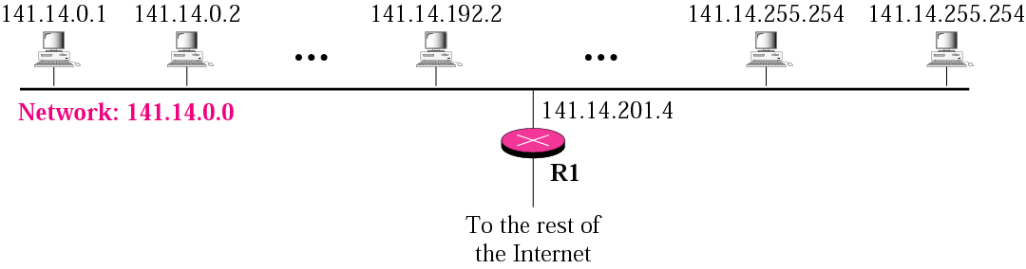
A network with two levels of hierarchy (not sub netted)

Slide 4
Subnetting
Subnetting is a process of dividing a single large network in multiple smaller networks.
A single large network is just like a town without any sector and street address
Subnetting is done by borrowing bits from the host part and add them the network part

Slide 5
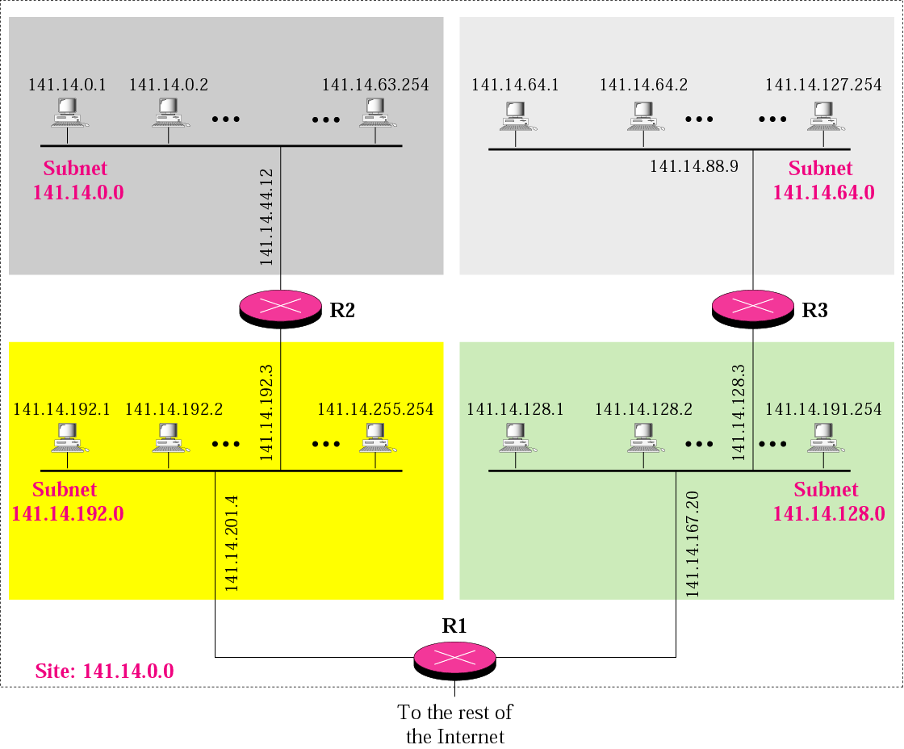
A network with three levels of
hierarchy (subnetted)

Slide 6
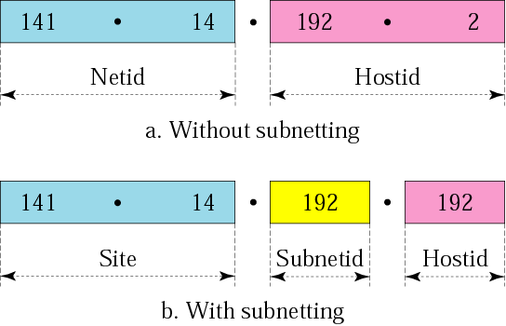
Addresses in a network with and without subnetting

Slide 7
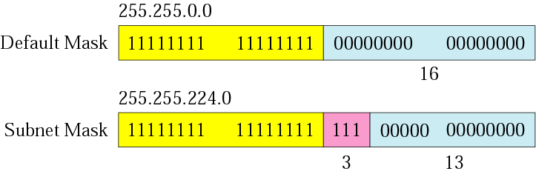
Comparison of a default mask and
a subnet mask

Slide 8
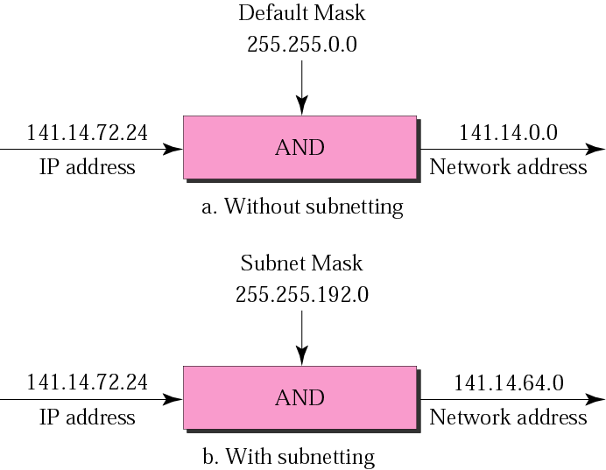
Default mask and subnet mask

Slide 9
Finding the Subnet Address
Given an IP address, we can find the subnet address the same way we found the network address. We apply the mask to the address.

Slide 10
Example 1
What is the sub network address if the destination address is 200.45.34.56 and the subnet mask is 255.255.240.0?

Slide 11
Solution
11001000 00101101 00100010 00111000
11111111 11111111 11110000 00000000
11001000 00101101 00100000 00000000
The subnetwork address is 200.45.32.0.

Slide 12
Example 2
What is the subnetwork address if the destination address is 19.30.80.5 and the mask is 255.255.192.0?
Solution
See next slide

Slide 13
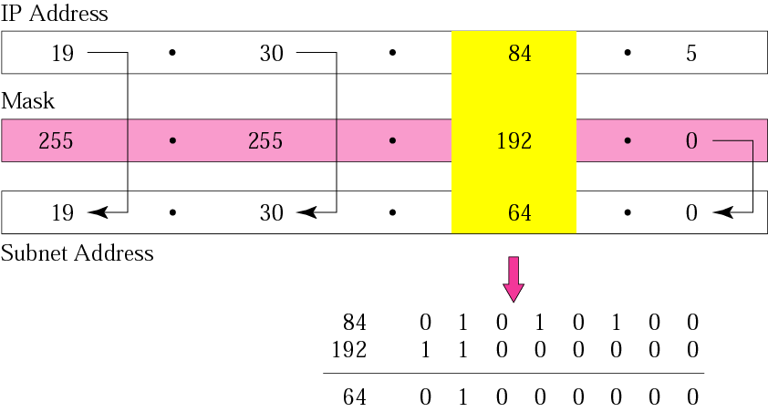
Solution

Slide 14
The number of subnets must be a power of 2.

Slide 15
Example 3
A company is granted the site address 201.70.64.0 (class C). The company needs six subnets. Design the subnets.
Solution
The number of 1s in the default mask is 24 (class C).

Slide 16
Solution (Continued)
The company needs six subnets. This number 6 is not a power of 2. The next number that is a power of 2 is 8 (2³). We need 3 more 1s in the subnet mask. The total number of 1s in the subnet mask is 27 (24 + 3).
The total number of 0s is 5 (32 − 27). The mask is

Slide 17
Solution (Continued)
11111111 11111111 11111111 11100000
or
255.255.255.224
The number of subnets is 8.
The number of addresses in each subnet is 2⁵ (5 is the number of 0s) or 32.
See Next slide

Slide 18
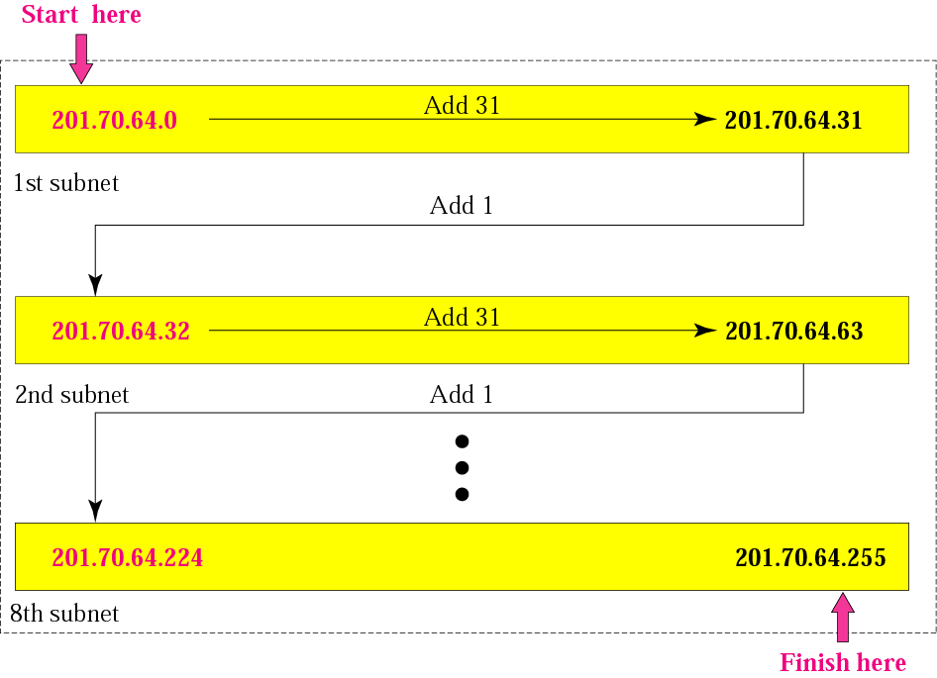
Example 3

Slide 19
Example 4
A company is granted the site address 181.56.0.0 (class B). The company needs 1000 subnets. Design the subnets.
Solution
The number of 1s in the default mask is 16 (class B).

Slide 20
Solution (Continued)
The company needs 1000 subnets. This number is not a power of 2. The next number that is a power of 2 is 1024 (2¹⁰). We need 10 more 1s in the subnet mask.
The total number of 1s in the subnet mask is 26 (16 + 10).
The total number of 0s is 6 (32 − 26).

Slide 21
Solution (Continued)
The mask is
11111111 11111111 11111111 11000000
or
255.255.255.192.
The number of subnets is 1024.
The number of addresses in each subnet is 2⁶ (6 is the number of 0s) or 64.
See next slide

Slide 22
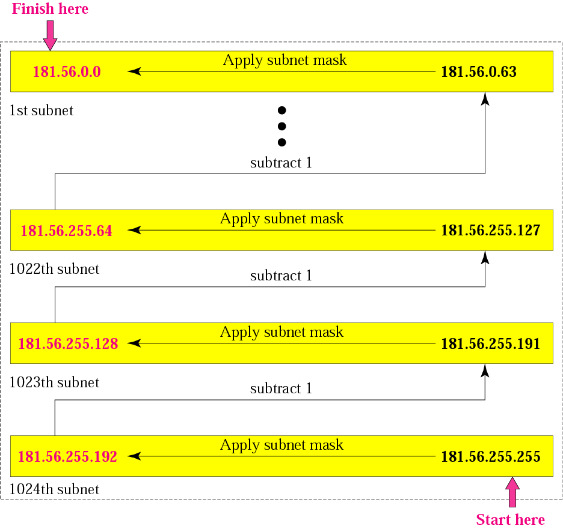
Example 12

Slide 23
Example 5
Imagine, you are a network administrator, and your network address is 170.170.0.0. Your authority asks to make subnets where each subnet will contain 1024 usable hosts.
How many subnet can be achieved?
What is the subnet mask?
What is the IP address of the 1st subnet?
What is the IP address of the last subnet?
What is the broadcast address if the second subnet?

Slide 24
Example 5
170.170.0.0.

Slide 25
Solution
Host bit needed=11,No of subnet=32
11111111.11111111.11111000.00000000
170.170.0.0
170.170.248.0
170.170.15.255

Slide 26
Example 6
Let you are a network administrator and your network address is 180.180.0.0. Your authority asks to make subnets where each subnet will contain 512 usable hosts.
How many subnet can be achieved?
What is the subnet mask?
What is the IP address of the last subnet?
What is the broadcast address if the second subnet?

Slide 27
Solution
Host bit needed=10,No of subnet=64
11111111.11111111.11111100.00000000
180.180.252.0
180.180.7.255

Slide 28
Example 6
What is the maximum number of subnet in class c using the following mask?
255.255.255.192
255.255.255.240

Slide 29
Solutuins
i. 4
ii. 16

Slide 30
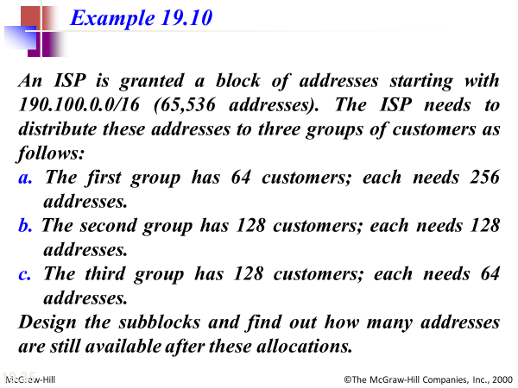

Slide 31
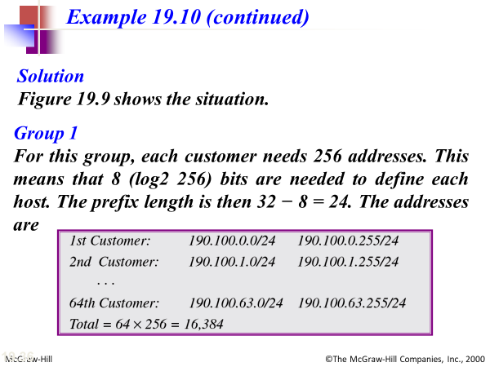

Slide 32
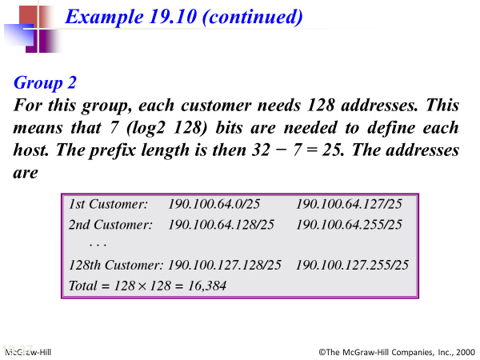

Slide 33
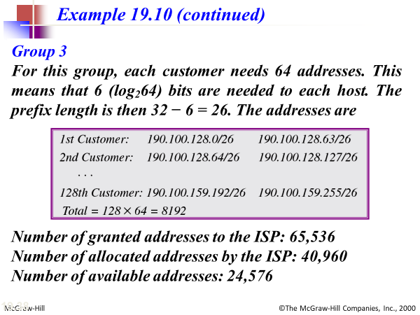

Slide 34
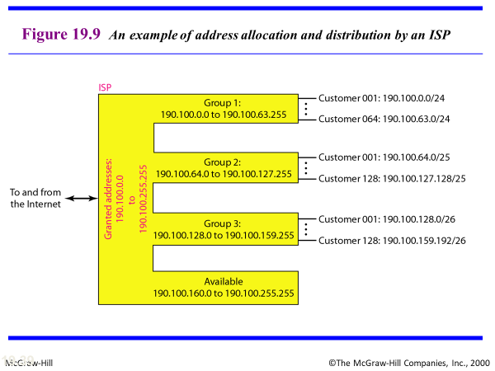

Slide 35
Suppose, one day your supervisor saying here is the network id 192.168.4.0 please create three subnets for our company. One subnet is the officers, one for front desk and storage room and one the public use. Now you task is to list each network ID, subnet mask, Host ID range of usable host and broadcast id

Slide 36
CLASSLESS
ADDRESSING

Slide 37
Disadvantage of Classful Addressing
Class A with a mask of 255.0.0.0 can support 16, 777, 214 addresses
Class B with a mask of 255.255.0.0 can support 65, 534 addresses
Class C with a mask of 255.255.255.0 can support 254 addresses

Slide 38

Slash notation

Slide 39
Slash notation is also called CIDR notation.

Slide 40
Example 17
A small organization is given a block with the beginning address and the prefix length 205.16.37.24/29 (in slash notation). What is the range of the block?

Slide 41
Solution
The beginning address is 205.16.37.24. To find the last address we keep the first 29 bits and change the last 3 bits to 1s.
Beginning: 11001111 00010000 00100101 00011000
Ending : 11001111 00010000 00100101 00011111
There are only 8 addresses in this block.

Slide 42
Example 17 cont’d
We can find the range of addresses in Example 17 by another method. We can argue that the length of the suffix is 32 − 29 or 3. So there are 2³ = 8 addresses in this block. If the first address is 205.16.37.24, the last address is 205.16.37.31 (24 + 7 = 31).

Slide 43
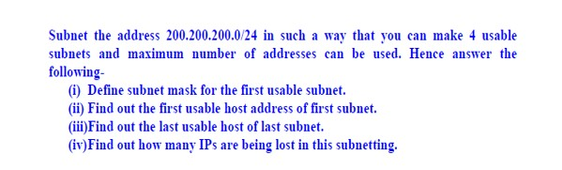
Question 1

Slide 44
Question 2
➔ Suppose Varendra University has a range of IP address 200.200.0.0/16.You have to create at least 15 usable subnets so that each subnet contains as many host as possible. Answer the following
What is the class of the given IP block ?
How many usable Ip address there in each subnet ?
What will be the subnet mask of the fourth subnet ?
What will be the second usable IP address of the third subnet ?

Slide 45
Question 3
For example, assume that you are a network administrator and buy 192.168.1.0/24 for Laxmisoftwares. Company has three departments connected with wan links.
• Development department has 74 computers.
• Production department has 52 computers.
• Administrative department has 28 computers.

